Slide 1
DS 502
House Price Prediction
Team 17
Weiqing Li Dekun Geng Yang Tao

Slide 2
CONTENT
01
02
03
04
Data
Pre-processing
Introduction
Models
Conclusion

Slide 3
Introduction
PART 1
Motivation
Data Description

Slide 4
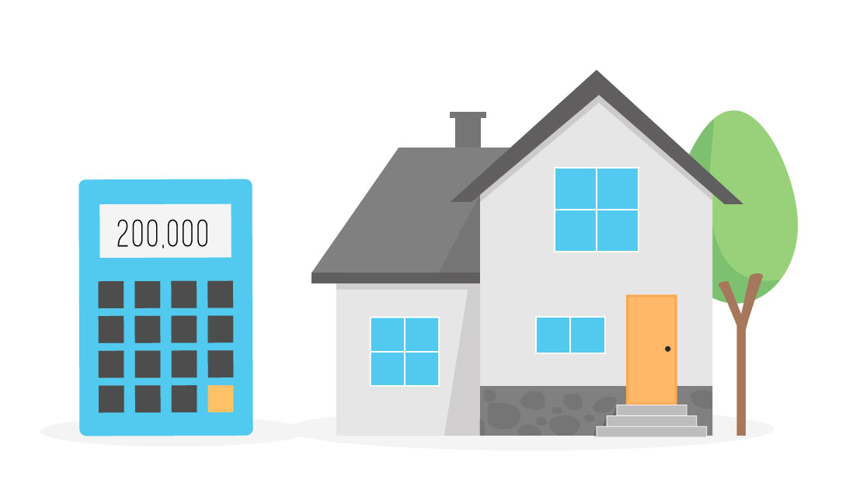
Motivation
Keywords
Keywords
96%
76%
Linear?
Non-linear?
Curabitur vitae magna eleifend at viverraligula. Sed dictum finibus vitae nunc egestas.
Keywords
Keywords
80%
56%
Curabitur vitae magna eleifend at viverraligula. Sed dictum finibus vitae nunc egestas.

Slide 5
Data Description
Real estate properties Los Angeles, Orange and Ventura, California
Train Data
Transactions before October 15, 2016, plus some of the transactions after October 15, 2016
Test Data
The rest of the transactions between October 15 and December 31, 2016
79 Predictors
Character: 43 Integer: 36

Slide 6
PART 2
Data Pre-processing

Slide 7
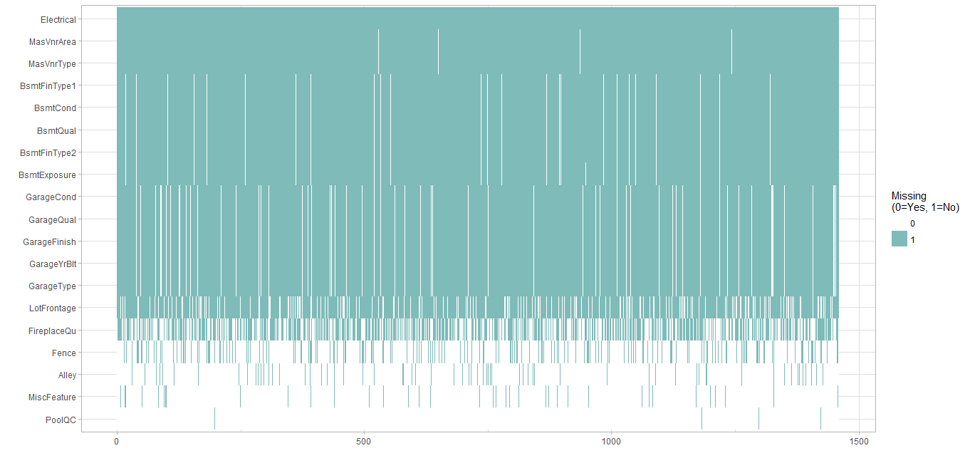

Slide 8
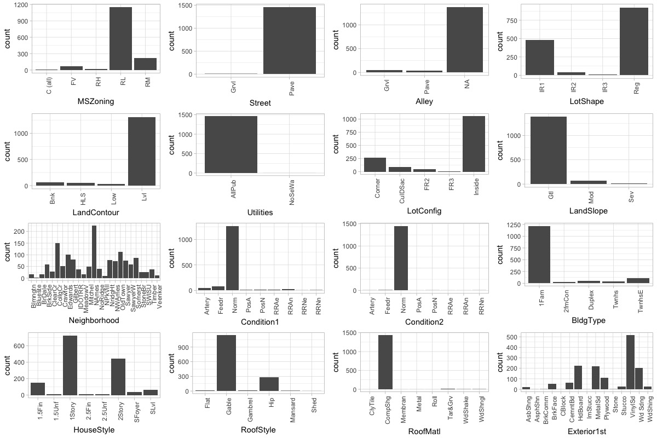

Slide 9
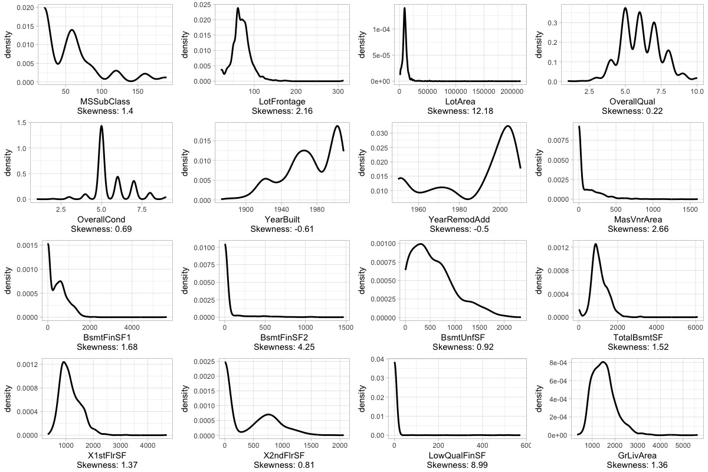

Slide 10
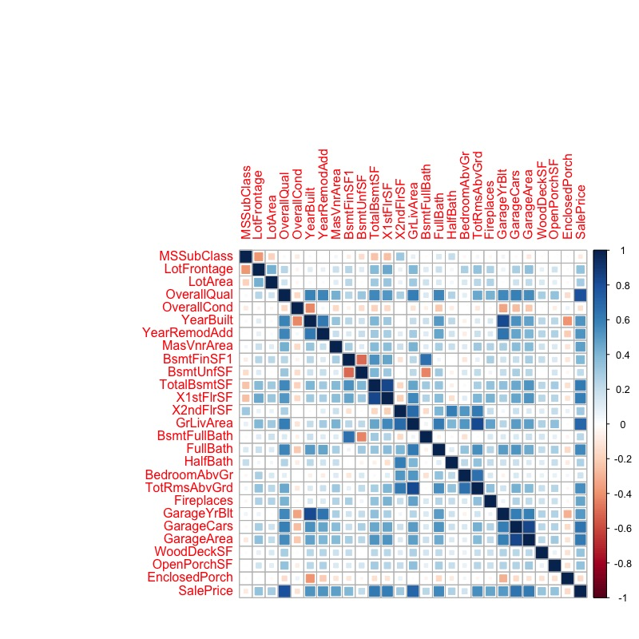

Slide 11
Correlation
OverallQual * GrLivArea
YearBuilt * YearRemodAdd * GarageYrBlt
BsmtFinSF1 * BsmtFullBath
TotalBsmtSF * X1stFlrSF
X2ndFlrSF * GrLivArea
X2ndFlrSF * HalfBath
X2ndFlrSF * FullBath
X2ndFlrSF * TotRmsAbvGr
GrLivArea * FullBath
GrLivArea * TotalBsmtSF
GarageYrBlt * GarageCars

Slide 12
Models
Feature Engineering - Lasso
Linear Regression
Random Forest
XGBoost
PART 3

Slide 13
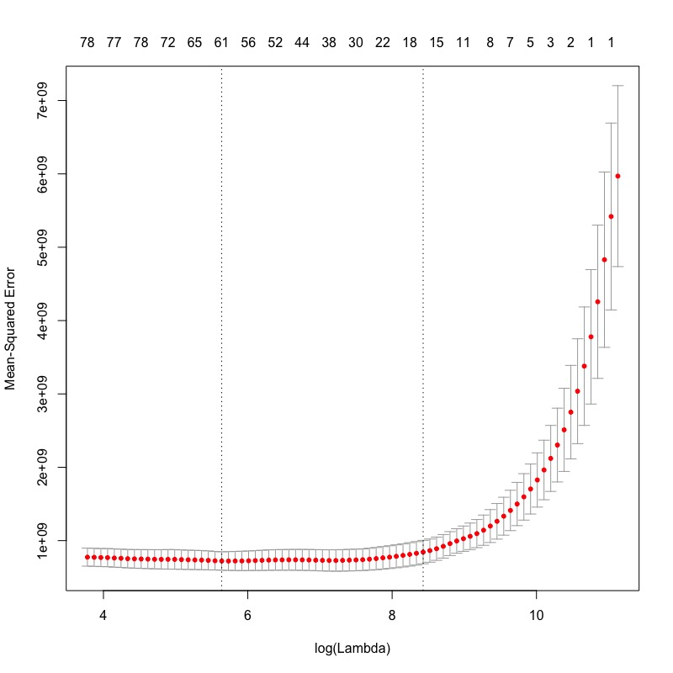
Lasso
Lambda=281

Slide 14
Lasso
(Intercept) | MSZoning | LotFrontage
-5.829838e+05 | -6.282371e+03 | 4.896984e+00
LotArea | Street | LotShape
5.450050e-01 | 3.362577e+04 | -1.529167e+03
LandContour | LotConfig | LandSlope
-4.924609e+02 | -2.352634e+00 | -1.322996e+02
Neighborhood | Condition2 | BldgType
-1.939768e+02 | -4.739957e+03 | -8.751606e+02
OverallQual | OverallCond | YearBuilt
-1.889713e+01 | 8.070050e+03 | 1.733180e+02
RoofStyle | RoofMatl | Exterior2nd
-2.963215e+02 | -2.517580e+03 | -1.121893e+01
MasVnrType | MasVnrArea | ExterQual
4.304220e+03 | 1.095773e+01 | -5.732028e+03
ExterCond | Foundation | BsmtQual
9.772344e+02 | -2.072490e+03 | -8.163616e+03
BsmtFinType1 | BsmtFinSF1 | BsmtFinSF2
8.062700e+02 | 1.335974e+00 | 1.478744e+00
BsmtUnfSF | Heating | HeatingQC
-4.920934e+00 | -2.537431e+03 | -1.797482e+03
Electrical | X2ndFlrSF | LowQualFinSF
1.454621e+03 | -3.398747e+01 | -6.721986e+01
GrLivArea | BsmtFullBath | BsmtHalfBath
-7.708308e-01 | -3.811554e+03 | -3.790915e+02
FullBath | BedroomAbvGr | KitchenAbvGr
-3.199190e+03 | -6.842280e+03 | -1.500204e+04
KitchenQual | TotRmsAbvGrd | Functional
-7.343990e+03 | 3.275203e+03 | 2.644124e+03
Fireplaces | GarageType | GarageYrBlt
1.421483e+03 | 2.109724e+02 | 1.045589e+02
GarageFinish | GarageArea | GarageCond
1.539300e+03 | 3.671830e+00 | -3.346074e+02
PavedDrive | WoodDeckSF | OpenPorchSF
3.793755e+03 | 2.218694e+00 | 8.330252e+00
EnclosedPorch | X3SsnPorch | ScreenPorch
-4.068948e-01 | 4.831392e+00 | 5.253292e+01
PoolQC | Fence | MiscFeature
1.663007e+04 | 1.988279e+03 | -5.752141e+03
MiscVal | YrSold | SaleType
9.896720e+00 | 3.655679e+01 | -8.050931e+02
SaleCondition | livarea_qual | bsmtFin_Bsmtfb
6.211596e+03 | 6.597914e+00 | 1.596383e+01
X2ndFlrSF_livarea | livarea_TotRmsAbvGr
1.546996e-02 | 1.331264e-02

Slide 15
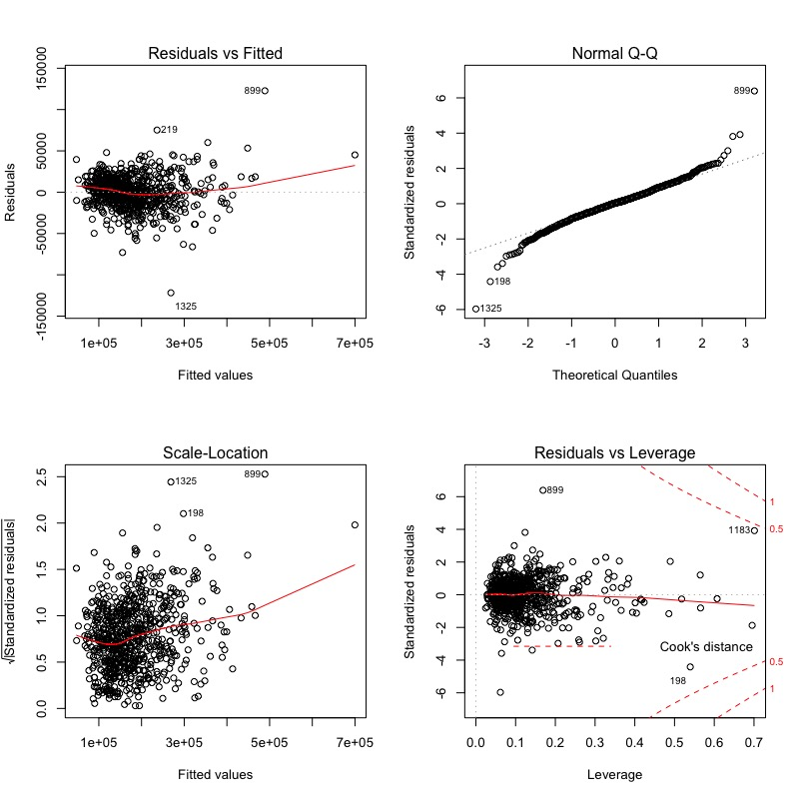
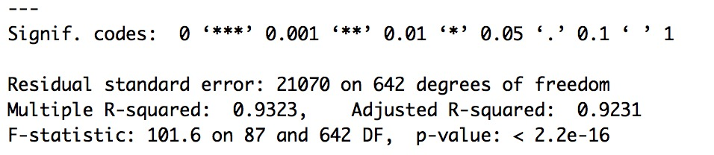
Linear Regression
RMSE: 0.1834

Slide 16
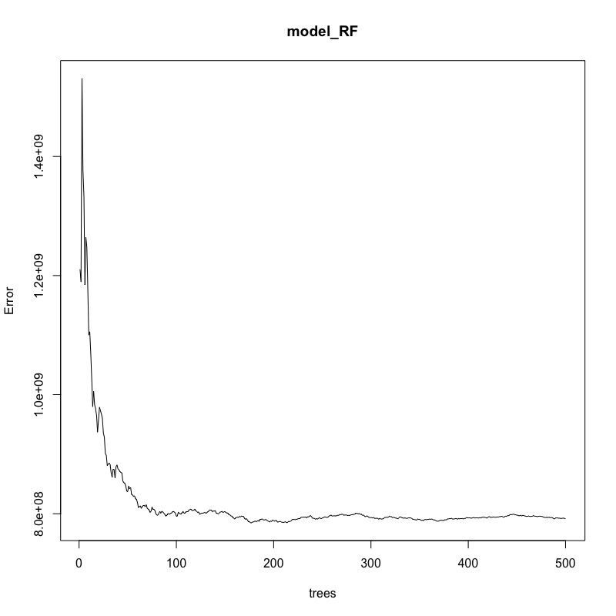
Random Forest
RMSE: 0.1540.

Slide 17
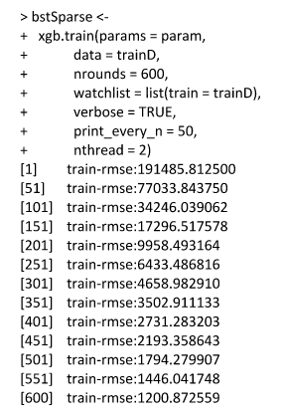
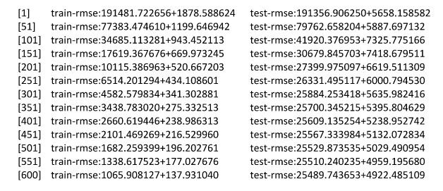
XGBoost

Slide 18
PART 4
Conclusion

Slide 19
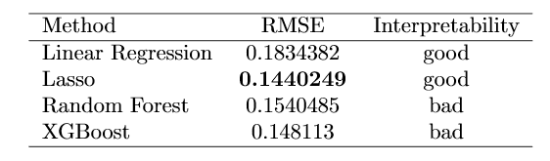
Conclusion

Slide 20
END
THANK YOU

